Slide 1
changing
Real Food - Real Hope
direction
UNDERSTANDING DIABETES
(and OBESITY)
It’s Not Your Fault: Part 2
The advice is wrong
Jeremy Martin
Ambassador for the PHC
Associate with Think Healthy Me

Slide 2
This presentation is for information only. It is not medical advice. Please discuss any dietary changes with your doctor. If on medications for type 2 diabetes this Practical Guide can be passed to your doctor.
Adapting diabetes medication for low carbohydrate management of type 2 diabetes: a practical guide.
Campbell Murdoch, David Unwin, David Cavan, Mark Cucuzzella and Mahendra Patel
Available on Diabetes Thanet website – Useful links, Adapting medications for low carb for T2D

Slide 3
Is the current dietary advice failing to curb diabetes and obesity?

Slide 4
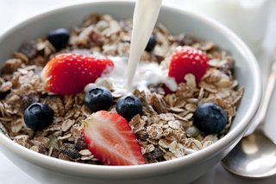
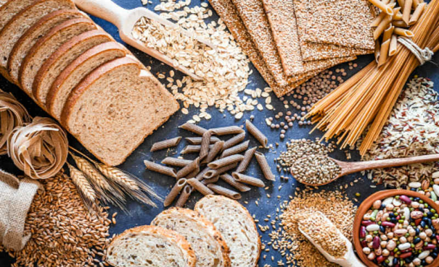
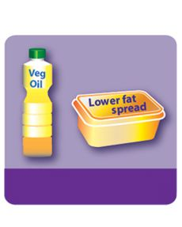
NHS Tips for Heathy Eating
Do not skip breakfast - a wholegrain lower sugar cereal with semi-skimmed milk and fruit sliced over the top is a tasty and healthier breakfast.
Choose higher fibre or wholegrain varieties, such as whole-wheat pasta, brown rice or potatoes with their skin
Cut down on your saturated fat intake and choose foods that contain unsaturated fats instead, such as vegetable oils and spreads

Slide 5
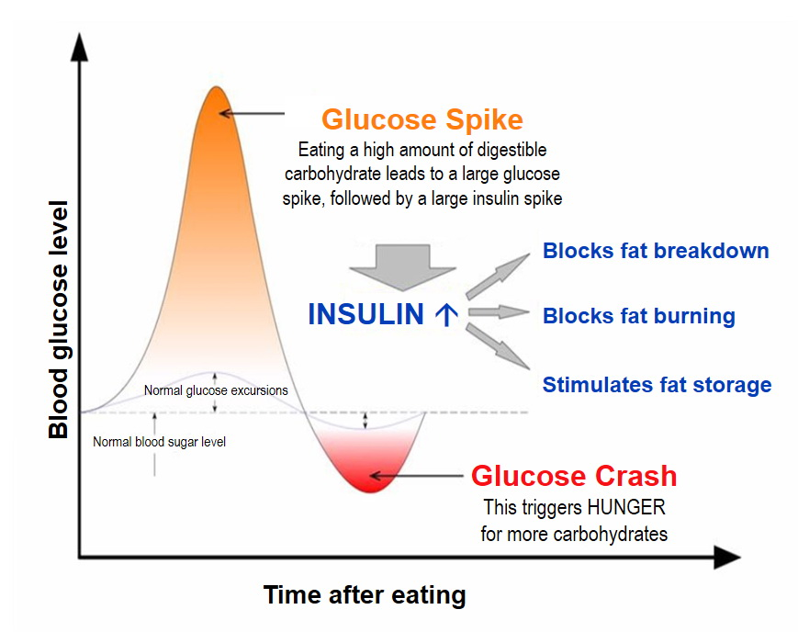
a wholegrain lower sugar cereal with semi-skimmed milk and fruit is a healthier breakfast
80g - carbs
15g - fat
14g - protein
7g - fibre

Slide 6
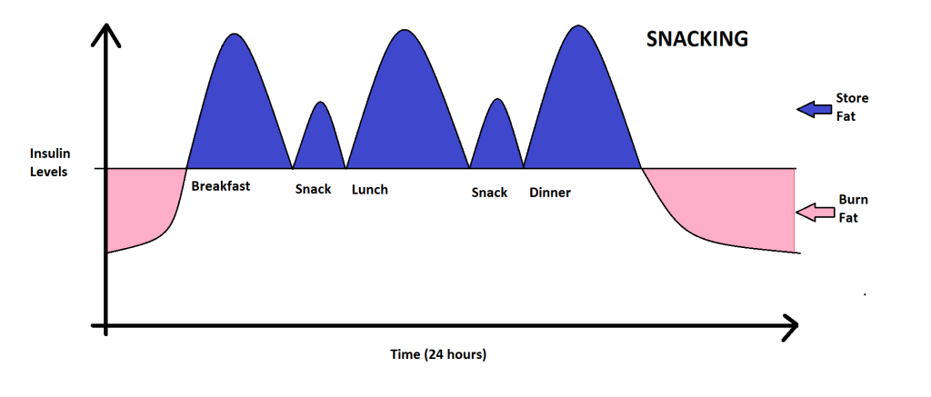
Store Fat
Insulin Levels
Breakfast
Lunch
Dinner
Burn Fat
Store Fat
Insulin Levels
Breakfast Snack Lunch Snack Dinner
Burn Fat
Freshwell Low Carb Project (lowcarbfreshwell.co.uk)

Slide 7
Eating occasions
A study in North Carolina from 1977 to 2002 found that eating occasions, which they defined as meals plus significant snacks, rose on average from 3.5 to 5 and the gap between eating fell from 4.5 to 3.5 hours.
In the same period obesity rates went from 13% to 30%.

Slide 8
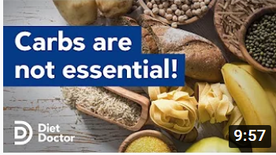
Choose higher fibre or wholegrain varieties
NHS say there is “strong evidence” high fibre diets reduce risk of CVD and type 2 diabetes, but:
Randomised controlled trials did not demonstrate an effect of dietary fibre intake on type 2 diabetes or cardiovascular risk factors.
www.nutrition.org.uk/nutritionscience/nutrients-food-and-ingredients /dietary-fibre
“The lower limit of dietary carbohydrate compatible with life apparently is zero, provided that adequate amounts of protein and fat are consumed.”
Dietary Reference Intakes, Food and Nutrition Board, Institute of Medicine, USA 2005
1 October 2021

Slide 9
Cut down on your saturated fat intake choose vegetable oils and spreads
Lowest Sat Fat intake (3.9-7.3%) | Highest Sat Fat intake (13.9-15.5%)
Bosnia & Herzegovina | France
Georgia | Switzerland
Tajikistan | Netherlands
Azerbaijan | Iceland
Moldova | Belgium
Croatia | Finland
Armenia | Austria
Average Sat Fat intake 6% | Average Sat Fat intake 15%
CHD deaths /100,000 | CHD deaths /100,000
117 (Men) | 39 (Men)
41 (Women) | 9 (Women)
Dr Zoe Harcombe, PhD

Slide 10
Cut down on your saturated fat intake choose vegetable oils and spreads
Sydney Diet Heart Study, 1966 - 1973.
Re-evaluation published February 2013
458 men aged 30-59 years with a recent coronary event
Intervention group replaced dietary saturated fats with omega 6 linoleic acid (safflower oil and safflower oil polyunsaturated margarine)
Control group received no specific dietary instruction
“Substituting dietary omega-6 linoleic acid in place of saturated fat increased the risks of death from all causes, coronary heart disease and cardiovascular disease.”

Slide 11
Cut down on your saturated fat intake choose vegetable oils and spreads
Replacement of saturated fat with vegetable oils rich in linoleic acid (omega-6)
The study hypothesis
Cholesterol in blood
Decrease
Coronary heart disease events and deaths
Decrease

Slide 12
Cut down on your saturated fat intake choose vegetable oils and spreads
Replacement of saturated fat with vegetable oils rich in linoleic acid (omega-6)
What the results showed
Unexpected findings
Cholesterol in blood
Coronary heart disease deaths
Increase

Slide 13
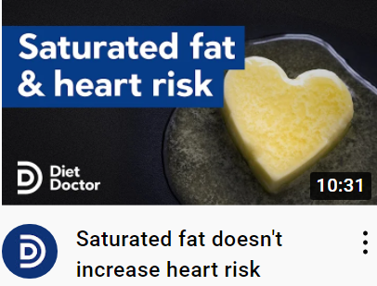
27 September 2021
A user guide to saturated fat - Diet Doctor 18 June 2021

Slide 14
Seed (vegetable) oils
Industrial Manufacturing Process
Spreads
Grinding
Pressing
Hexane Solvent
Solvent removal
Refine to remove colour and odour
Neutralising with caustic soda
Removal of soapstock
Degumming
Bleaching
Removal of waxes
Deodorising
De-acidification with caustic soda
Washing
Bleaching
Pasteurising mixers
Hydrogenation
Emulsifying, mixing
Colouring,
Flavouring
HVO – Hydrotreated Vegetable Oil is a replacement for diesel

Slide 15
Foods with Vegetable Oil
Battered fish
Biscuits
Bread, most
Cakes
Crisps
Mayonnaise
Oven chips
Pastry and anything with pastry
Roasted nuts
Salad dressings
Some ice cream
Some prepared meals
Some tinned fish
Some tinned soup
+ many restaurant meals

Slide 16
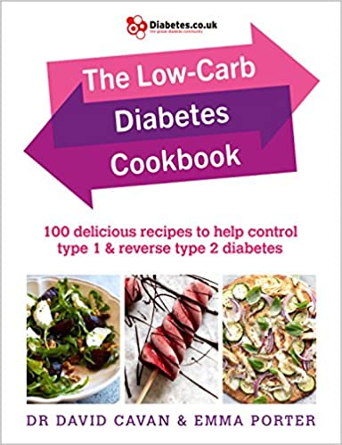
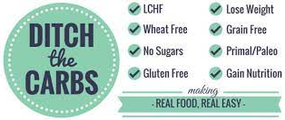
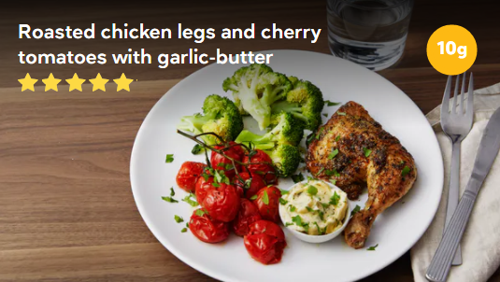
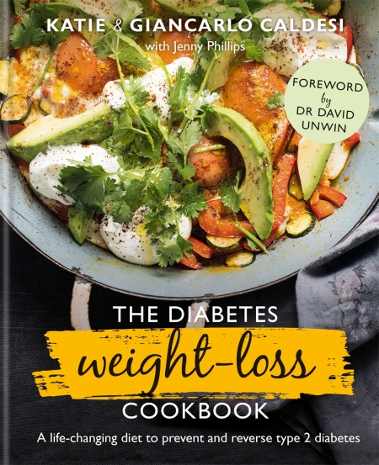
https://sites.google.com/view/letfoodbethymedicine/infopedia/sugar-infographics?authuser=0
THE LOW CARB KITCHEN
Low carb and keto on a budget

Slide 17
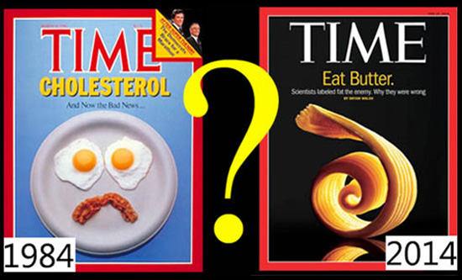
Summary
You don’t have to eat breakfast
Carbs are nice but not necessary
Vegetable oil is best used in diesel cars
Saturated fats do not cause heart disease
THANK YOU

