Slide 1
changing
Real Food - Real Hope
direction
Reverse the Advice
Reverse Diabetes and Obesity
Jeremy Martin
Ambassador for the PHC
Associate with Think Healthy Me

Slide 2
This presentation is for information only. It is not medical advice. Please discuss any dietary changes with your doctor. If on medications for type 2 diabetes this Practical Guide can be passed to your doctor.
Adapting diabetes medication for low carbohydrate management of type 2 diabetes: a practical guide.
Campbell Murdoch, David Unwin, David Cavan, Mark Cucuzzella and Mahendra Patel
Available on Diabetes Thanet website – Useful links, Adapting medications for low carb for T2D

Slide 3
There is a fundamental misunderstanding of the causes and treatment of obesity (and diabetes) and it is because of this flawed thinking by many experts and advisers that the obesity (and diabetes) crisis has become worse.
Dr Andrew Jenkinson, Bariatric Surgeon
University College London Hospital
Author – Why We Eat (Too Much)

Slide 4
Eat Less – Exercise More
advice given for 40+ years
Obesity rates
7% in 1980
30% today
4 million
20 million
Diabetes rates
1-2% in 1980
8% today
0.5 - 1 million
5 million

Slide 5
Adult Diabetes Rates (Diagnosed) England by Weight Category and Sex - 2019
Source: Health Survey for England, 2019: Overweight and obesity in adults and children data tables, Table 12 and Diabetes UK

Slide 6
NHS Management of Type 2 Diabetes
NHS website statements
Type 2 diabetes is a lifelong condition that can affect your everyday life.
Most people need medicine to control their type 2 diabetes. You may have to take it for the rest of your life.
Diabetes usually gets worse over time, so your medicine or dose may need to change.

Slide 7
Type 2 diabetes and prescriptions
2007/08 to 2017/18
37% increase in T2D rates in UK
73% increase in prescriptions for T2D in UK
Diabetes UK
“If the treatment is truly effective then shouldn’t the rates of the disorder be decreasing rather than increasing?”
Julia Rucklidge, Clinical Psychologist, Christchurch NZ
“You can’t use drugs to cure a dietary disease”
Dr Jason Fung, Author The Diabetes Code

Slide 8
It’s not your fault?
What affects obesity and diabetes?
Elevated insulin
Hunger and satiety hormones
Processed food addiction
Exercise is very important, but does not help much with weight loss
What you eat affects how much you eat

Slide 9
Timeline towards T2D diagnosis
1
3
4
2
1
Diabetes diagnosis
Pre-diabetes
Time (years/decades)

Slide 10
HEART DISEASE
ALZHEIMER’S
DIABETES
LOW TEST’E
PCOS
FATTY LIVER
SARCOPENIA
MIGRAINES
DEMENTIA
BODY FAT
CANCER
STROKE
OSTEO
ARTHRITIS
1
INSULIN RESISTANCE
Prof Ben Bikman, Plagues of Prosperity Lecture, July 2018

Slide 11
The Impact of Insulin
Cycle over time leading to high insulin levels
1
eat carbs
blood glucose up
insulin released
cells become insulin resistance
less fat / energy burning
more fat stored
High insulin lowers basal metabolic rate
High insulin inhibits fat burning
High Insulin converts more glucose to fat

Slide 12
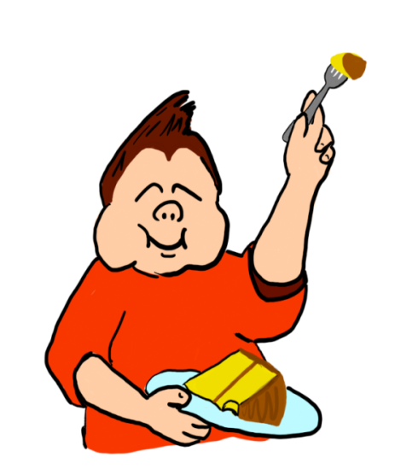
2
Hunger and hormones
“It is almost impossible to eat less when there is a little devil on your shoulders born from leptin resistance that is whispering to you eat more, get fatter”
Dr Ron Rosedale
You can’t decide to be less hungry.
Hunger will eventually win over willpower

Slide 13
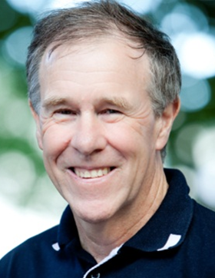
Processed Food Addiction
3
Anything that is essential to human survival is not addictive. We are only addicted to food with processed carbs.
Dr Robert Cywes, Bariatric Surgeon, Addiction expert
Sugar addiction is real. For some people, sugar is very dangerous and for others not quite so.
Bitten Jonsson RN, Food Addiction Expert
Problem is you can't "limit" addictive substances. It's all or nothing. That's why we have an obesity (and diabetes epidemic.)
Prof Tim Noakes on Twitter

Slide 14
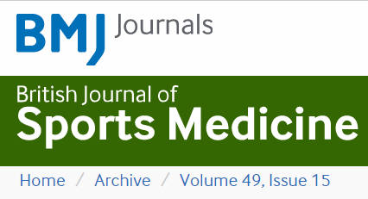
4
It is time to bust the myth of physical inactivity and obesity: you cannot outrun a bad diet
A Malhotra, T Noakes, S Phinney, April 2015
Regular physical activity reduces the risk of developing cardiovascular disease, type 2 diabetes, dementia and some cancers by at least 30%. However, physical activity does not promote weight loss.

Slide 15
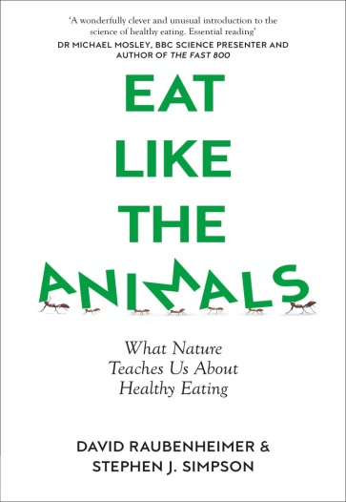
5
What you eat affects how much you eat
I see people reverse type 2 diabetes all the time
First of all you have to stop whatever you were doing to end up in the situation you are in
Ted Naiman, Medical Doctor, Researcher, Author
If you have a diet that is low in protein relative to fats and carbohydrates, you will overeat fats and carbohydrates to meet your protein target risking obesity.
David Raubenheimer, PhD Stephen Simpson PhD
Researchers, Authors of Eat Like The Animals
Protein adequacy is fundamental to satiety

Slide 16
3 Rules of 3
Avoid
Sugar
Refined grains
Seed oils / spreads
Eat Real Food
Meat / fish
Eggs
Fresh veg
Do
Prioritise Protein
Control Carbs
Stop fearing Fat

Slide 17
“It’s not your fault,
but it is your problem”
Dr Aseem Malhotra
To exercise personal responsibility you need knowledge and you need choice.
You can beat diabetes

